Slide 1
HTML Complete Course
Basic to Advance In Hindi 2024

Slide 2



HTML
Structure/Layout
CSS
Design/ Style
JS
Logic

Slide 3
HTML
HTML stands for HyperText Markup Language
It is used to create webpages.
It uses HTML tags and attributes to describe the structure and formatting of a web page.

Slide 4
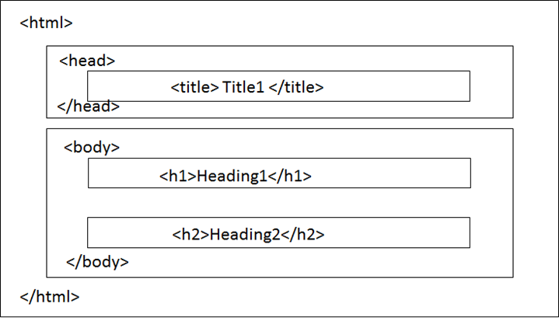
Structure of Html

Slide 5
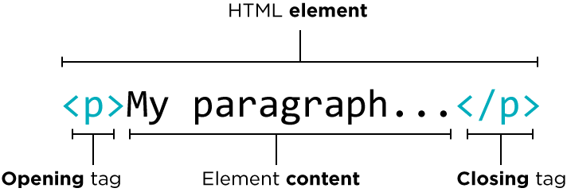
HTML Tags
A container for some content or other Html Tags.

Slide 6
Important Points
Html tag is parent of head & body tag.
Most of html elements have opening & closing tags with content in between them.
Some tags have no content in between, eg <br>
We can use inspect element/view page source to edit html

Slide 7


Slide 8
HTML is NOT case sensitive
<html> = <HTML>
<p> = <P>
<head> = <HEAD>
<body> = <BODY>

Slide 9


Slide 10
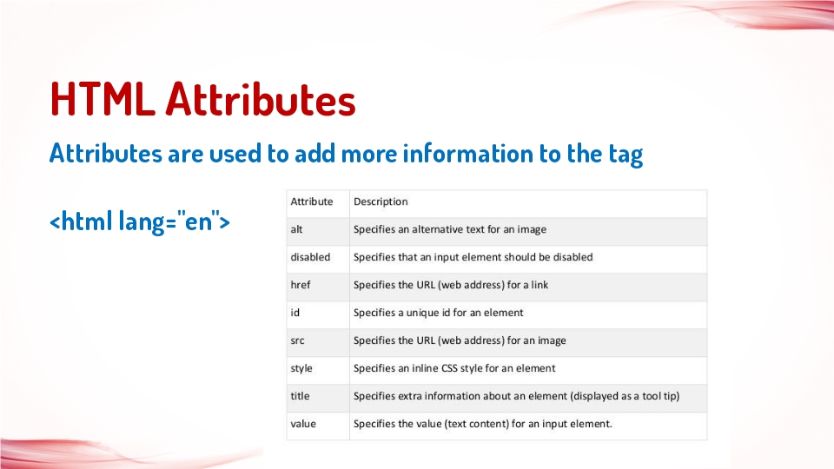

Slide 11
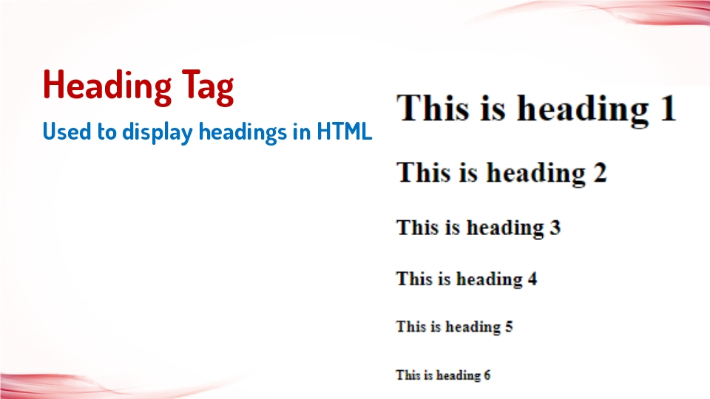

Slide 12
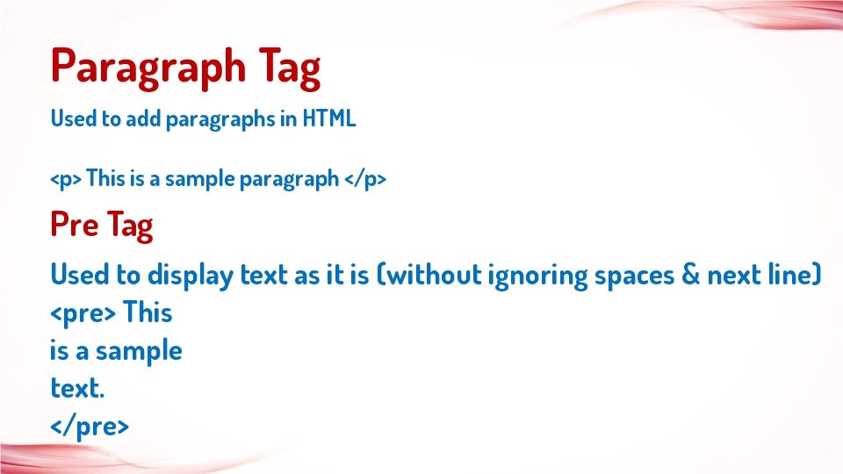

Slide 13
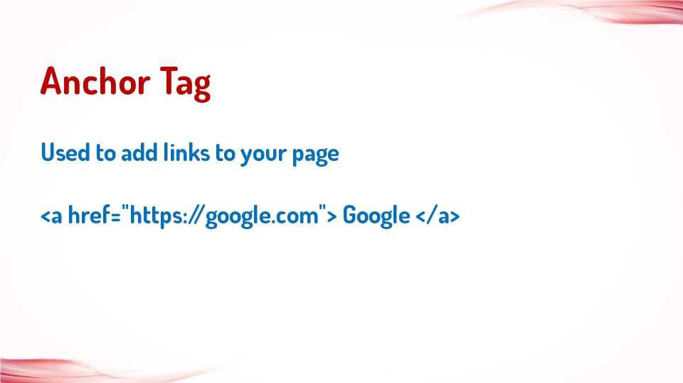

Slide 14
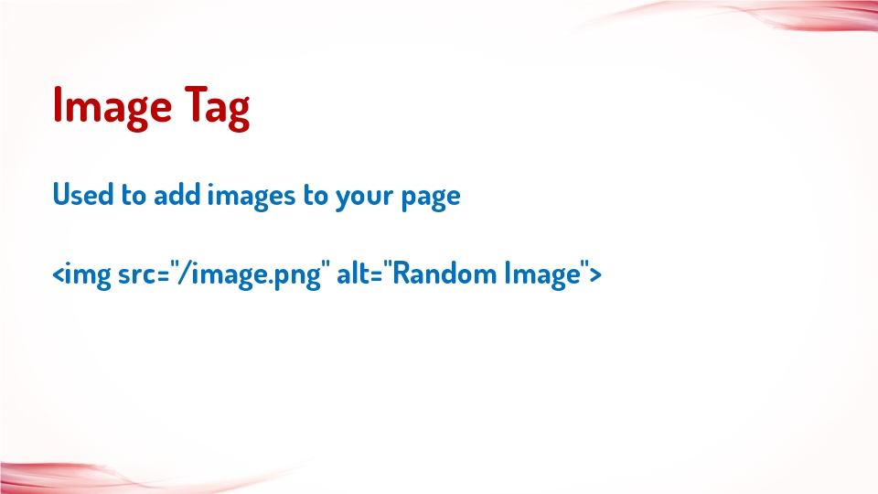

Slide 15
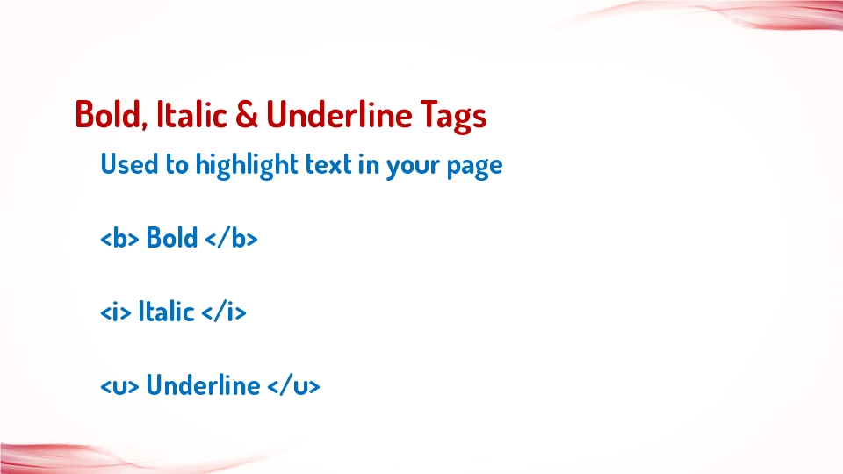

Slide 16
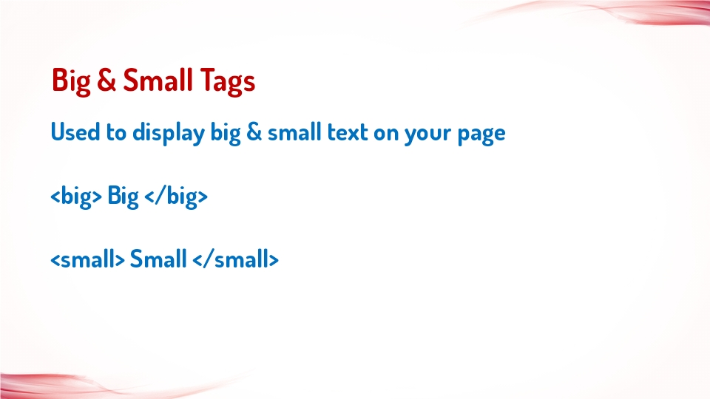

Slide 17
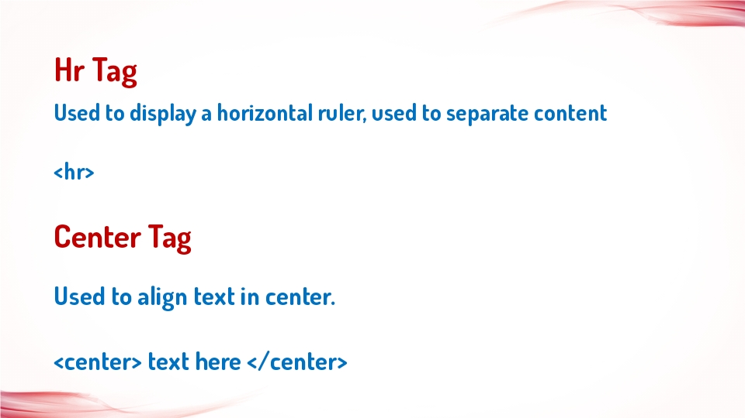

Slide 18
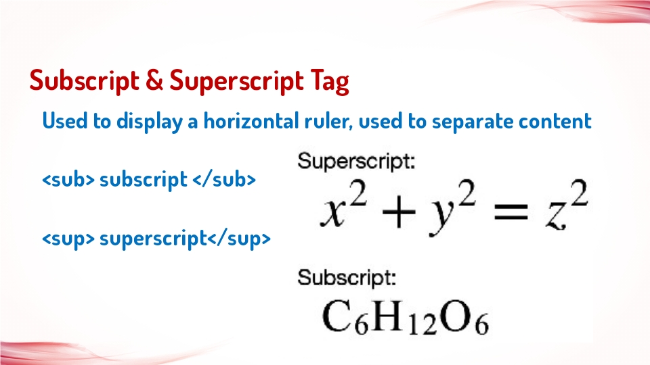

Slide 19


Slide 20
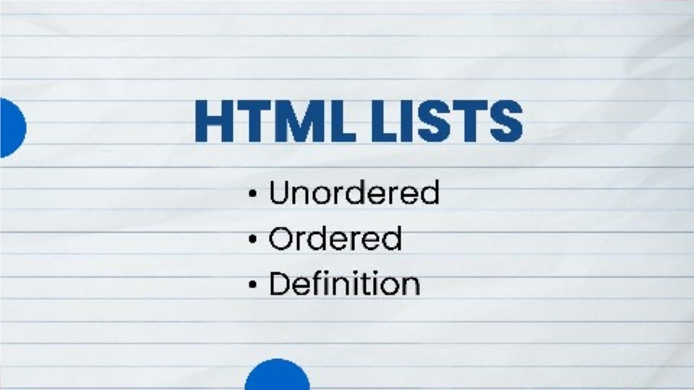

Slide 21


Slide 22


Slide 23
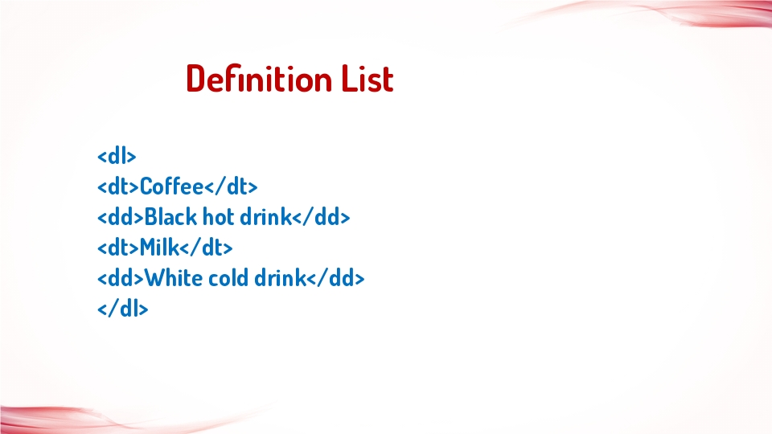

Slide 24
Tables in HTML

Slide 25
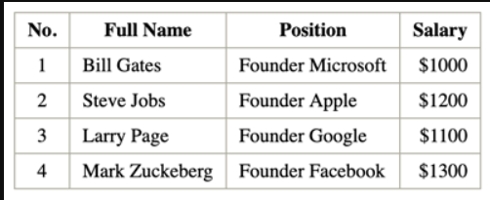
Tables in HTML
HTML tables allow web developers to arrange data into rows and columns.

Slide 26
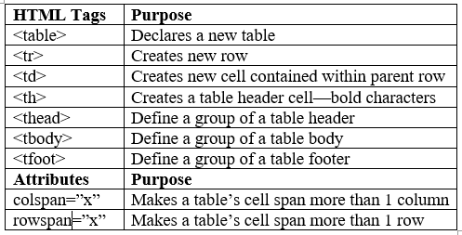

Slide 27
Forms In HTML
An HTML form is used to collect user input

Slide 28
HTML <form> Elements
Tag Description
<form> Defines an HTML form for user input
<input> Defines an input control
<textarea> Defines a multiline input control (text area)
<label> Defines a label for an <input> element
<select> Defines a drop-down list
<option> Defines an option in a drop-down list
<button> Defines a clickable button

Slide 29
<form> Element
The HTML <form> element is used to create an HTML form for user input:
<form>
form elements
</form>
The <form> element is a container for different types of input elements, such as: text fields, checkboxes, radio buttons, submit buttons, etc.

Slide 30
<input> Element
<input type="text" placeholder="Enter Name">
An <input> element can be displayed in many ways, depending on the type attribute
Type Description
<input type="text"> Displays a single-line text input field
<input type="radio"> Displays a radio button
<input type="checkbox"> Displays a checkbox
<input type="submit"> Displays a submit button
<input type="button"> Displays a clickable button

Slide 31
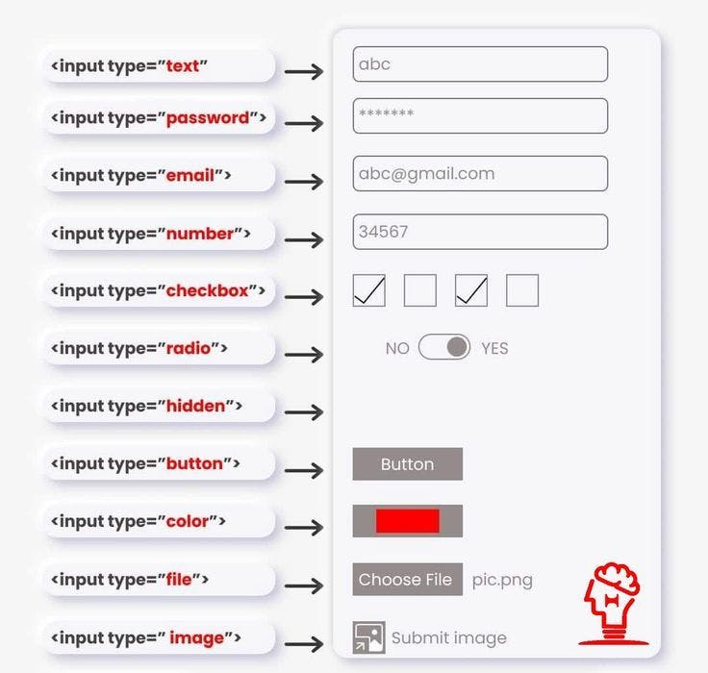

Slide 32
Select
<select name="city" id="city">
<option value="Delhi"> Delhi </option>
<option value="Mumbai"> Delhi </option>
<option value="Banglore"> Delhi </option>
</select>

Slide 33
Action in Form
Action attribute is used to define what action needs to be performed when a form is submitted
<form action="/action.php" >

Slide 34


